Slide 1
Tableau
Introduction

Slide 2
Structure of this workshop
Update from Dr. Fraser
10:00-11:20AM: Tableau intro
11:30-12:30PM:
Work on homework
Data available at (https://github.com/mjahmad/Tableau_Workshops)
Data and Presentation are there.

Slide 3
Update from Dr. Fraser
Next Assignment will be due on Monday 1/30/2023.
Ask Dr. Fraser questions if needed
Submit homework work on eCampus
(steps 1-7 of Getting started with Tableau)
Save as Tableau Packaged Workbook (.twbx)
Due on 1/30/2023: Ask Dr. Fraser for questions
Submission on eCampus

Slide 4
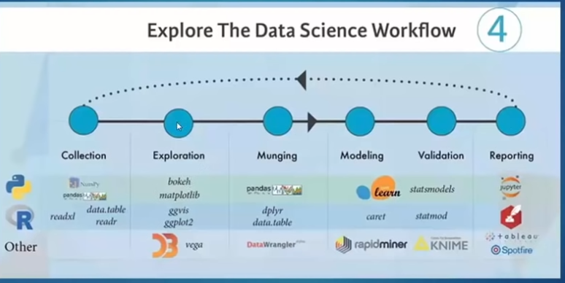
Data Science Workflow
Figure 1: Data Science Workflow [1]

Slide 5
What is Tableau?
An industrial Business Intelligence and data visualization tool
Allows user to make sense of data
Charts
Graphs
Diagrams
How is it different from Excel?
Welp, we will see.

Slide 6
Where can we Tableau?
Exploration phase:
Data Distribution
Outliers
Understand data, relationships among variables
Reporting Phase:
Share results
Good reporting tools
Still issues with exporting Figures to EPS.

Slide 7
Why use Tableau?
User Friendly
Allows rapid data exploration
Has sharing features
Connectivity:
Databases
Csv/ text files
Cloud

Slide 8
How do you get Tableau?
There are different editions of Tableau:
Tableau Desktop prices $35~70 / year
Tableau Server $35 / year
Tableau Online $42 /year
Tableau Desktop can be acquired from here -> 1-year free Student License

Slide 9
References
https://hevodata.com/learn/data-science-workflows/

